Slide 1
L5 in Tandem with L1
Future SWE Missions Workshop
ESA SSA/SWE State-of-Play
Nicolas Bobrinsky
London, 6 March 2017

Slide 2
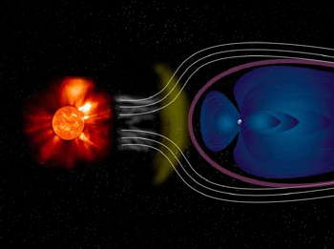
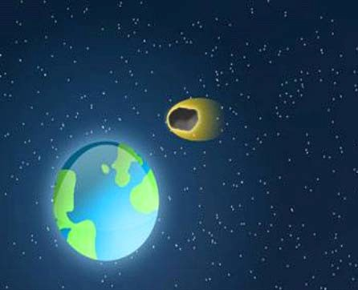
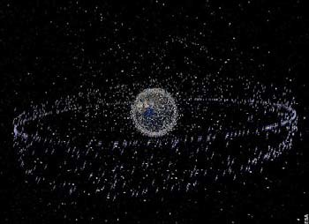
Space Situational Awareness - Goals
Society heavily dependent on critical space and ground assets (e.g s/c, power grids, networks)
These assets need to be protected against adverse effects from space
Three main areas addressed in the SSA programme:
SWE
NEO
SST
SWE
NEO
SST
Space Weather
Near Earth Objects
Space Surveillance and
Tracking

Slide 3
Objectives for a European SWE System
SSA Programme Declaration calls for: Independent European access to SSA (SWE) data and services
SSA (SWE) requirements
SSA (SWE) architecture
Implementation of SSA (SWE) system and demonstration of operability
Detection and forecasting of Space Weather and its effects
Monitoring of the Sun, solar wind, radiation belts,
magnetosphere, ionosphere
SWE Services to Users (e.g National Civil Protection Authorities)

Slide 4
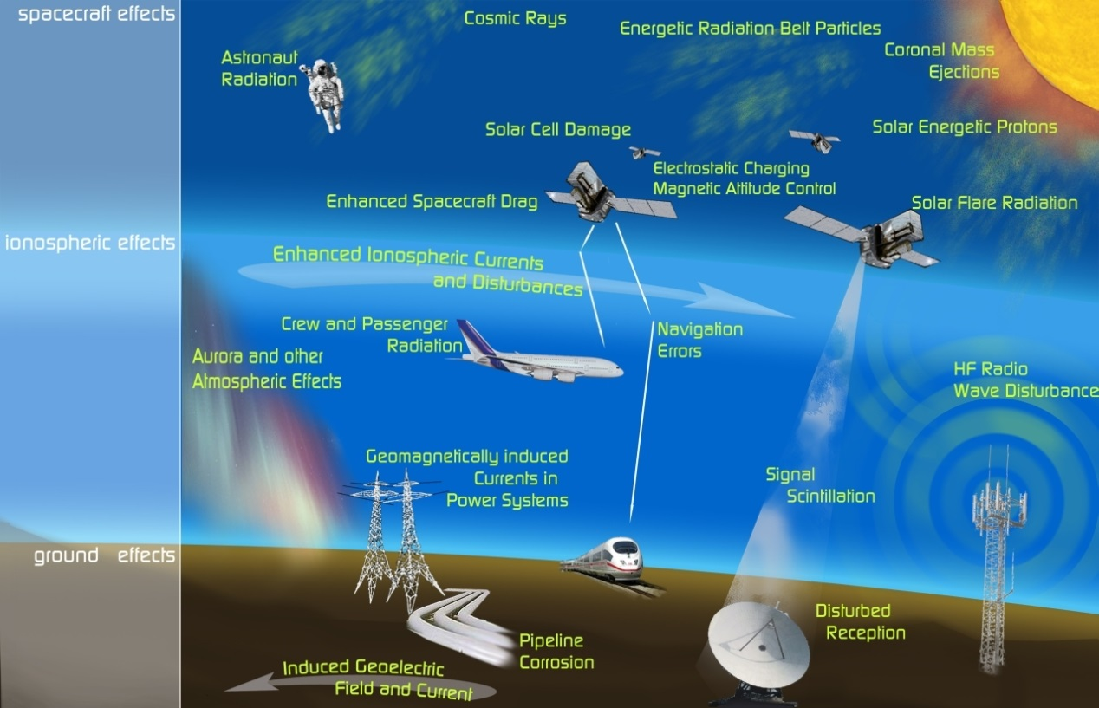
Space Weather impacts infrastructure and services on ground, in air and in space

Slide 5
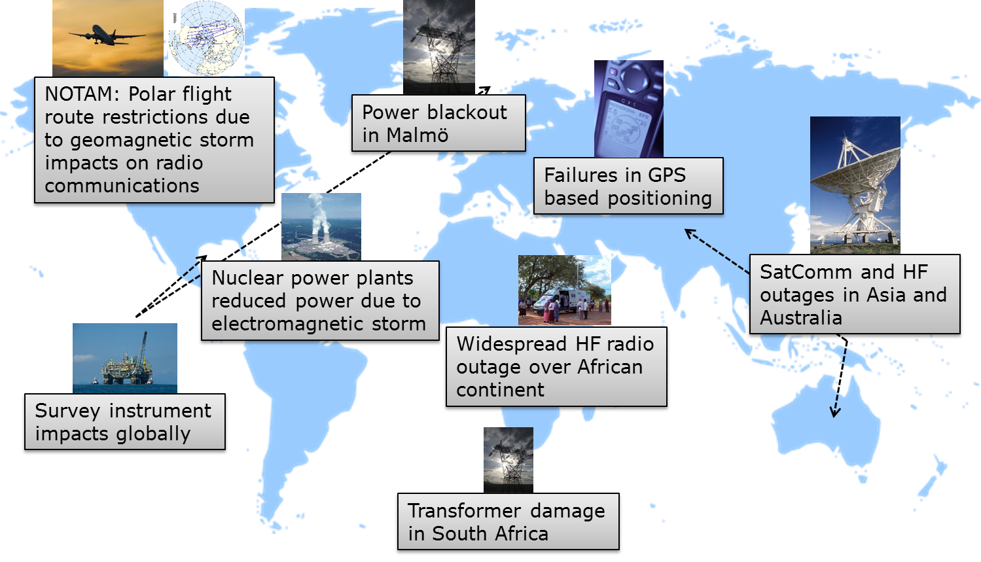
Effects of Space Weather during Halloween storm (Oct–Nov 2003)

Slide 6
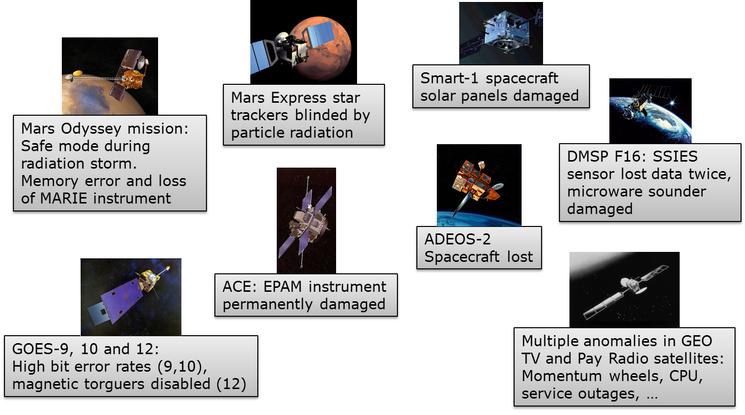
Effects on space missions during Halloween storm (Oct–Nov 2003)
Notes:
This is alternative to previous slide

Slide 7
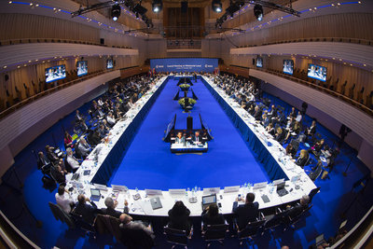
SSA Programme Decisions
SSA Programme initiated in April 2008 (ESA Council, SSA Enabling Resolution)
SSA Programme executed in Periods
Period 1 (2009-2012) decided at MC in November 2008 (The Hague, NL)
Period 2 (2013-2016) decided at MC12 in November 2012 (Naples, IT)
Period 3 (2017-2020) decided at MC16 in December 2016 (Lucerne, CH)

Slide 8
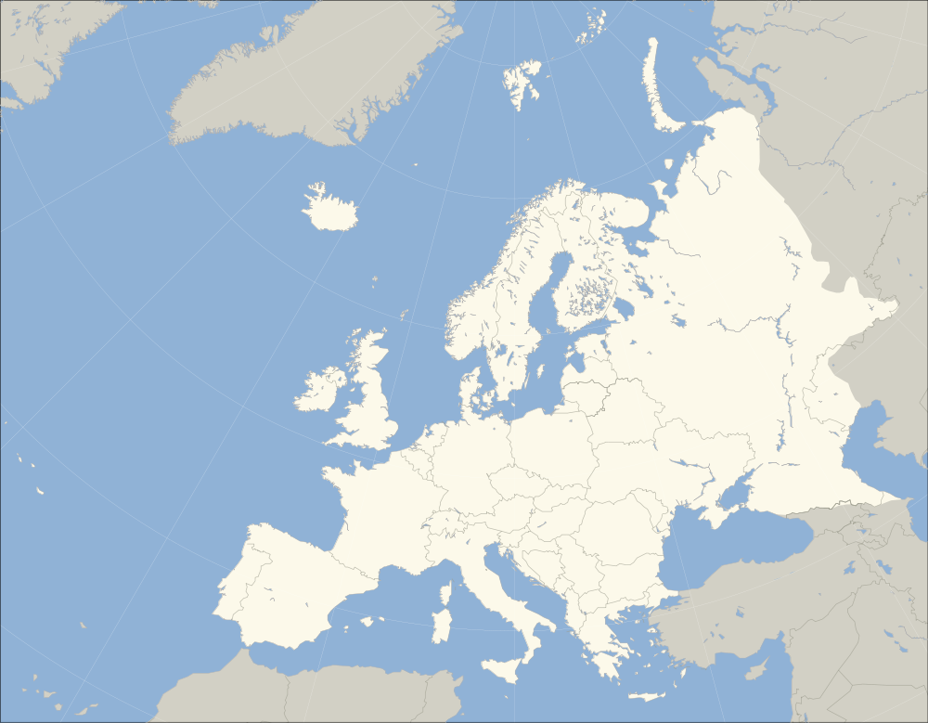
SSA Programme Participants in Period 3 (2017 – 2020)
Austria
Belgium
Czech Republic
Denmark
Finland
France
Germany
Greece
Italy
Luxembourg
Netherlands
Norway
Poland
Portugal
Romania
Spain
Sweden
Switzerland
United Kingdom
19 Participating States
Focus on Space Weather and L1/L5
Activities also in the areas of NEO and SST
Funding: 95.3 M€

Slide 9
SSA Programme status Priorities of MSs (status at 6 March 2017)
SWE: 17 PSs
NEO: 10 PSs
SST: 11 PSs
L1/L5: 7 PSs
Three main contributors to SSA Period 3:
UK: 22 M€
DE: 15.1 M€
IT: 11.3 M€
Geo-return constraints must be reflected when placing contracts
 | SWE | NEO | SST | L1/L5
AUSTRIA | x | x | x | x
BELGIUM | x | - | - | -
CZECH REPUBLIC | x | x | x | x
DENMARK | x
FINLAND | x | x | x | -
FRANCE | x | - | - | -
GERMANY | x | x | x | x
GREECE
ITALY | x | x | x | -
LUXEMBOURG | x | x
NETHERLANDS | x
NORWAY | x | - | x | -
POLAND | x | x | x
PORTUGAL
ROMANIA | x | x | x | x
SPAIN | x | x
SWEDEN | x | - | x | x
SWITZERLAND | x | x | x | x
UNITED KINGDOM | x | - | x | x

Slide 10
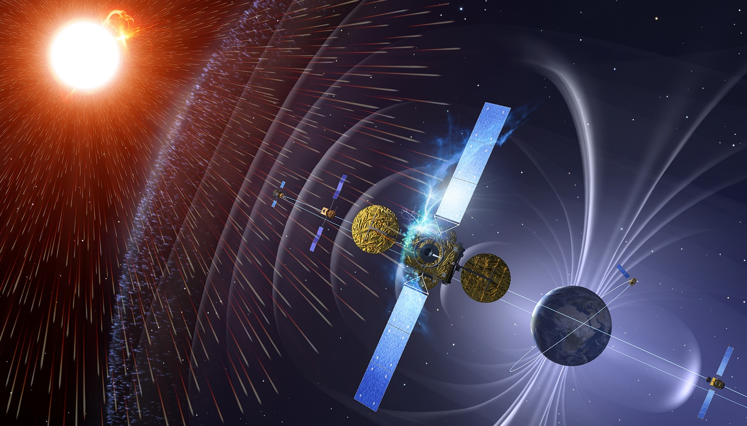
European SWE System Strategy
Build and implement coherent European SWE system integrating national SWE assets
Initial SWE system operational by 2020
Develop additional elements post-2020 (e.g. SWE mission to L5, SWE instrumentation, Research to Operations)
Ensure a consistent approach with the US (NOAA, NASA) for L1/L5 platforms, SWE instrumentation, stations cross-support
Operational phase, i.e. delivery to users 24/7, then open. Role for EU or other.

Slide 11
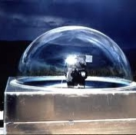
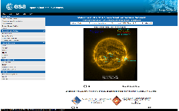
Networking European SWE Assets
SSA-SWE Users
SSA and collaborating sensor systems
Federated data archives
SSA SWE Coordination Centre
Space Pole, Belgium
SWE Data Centre
swe.ssa.esa.int
SWE Expert Service Centres
Solar Weather
Ionospheric Weather
Space Radiation
Geomagnetic Conditions
Heliospheric Weather
European expert groups and centres of excellence

Slide 12
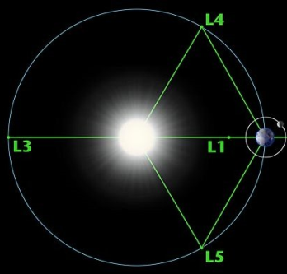
Enhanced SWE observation system: L5 + L1
Development of ASEL mission (L5):
Solar corona monitoring
Heliospheric imaging
Solar disc magnetic field
EUV imaging
In-situ measurements:
solar wind
magnetic field
charged particles
hot plasma
Mission phases in P3
A/B1
B2
Readiness for C/D

Slide 13
Examples of SWE services

Slide 14
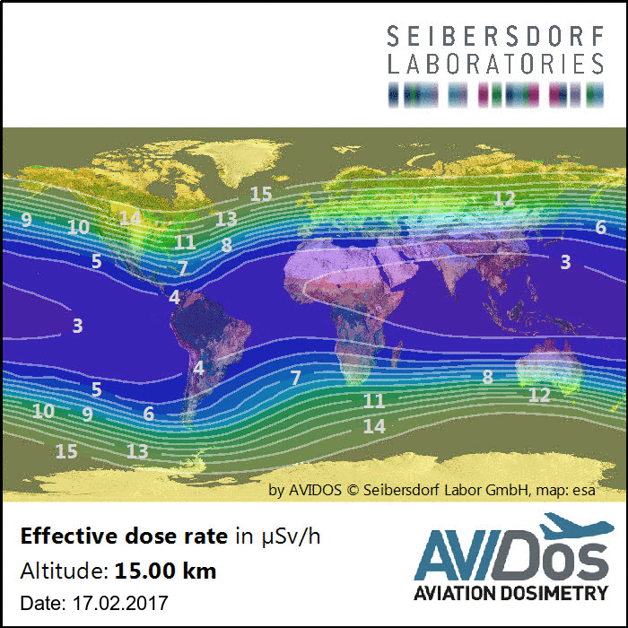
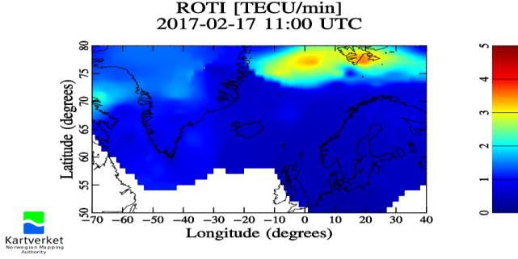
SWE Service For Aviation
Near real-time assessment of cosmic radiation exposure at flight altitudes.
Timely information about potential space weather-induced communication/ navigation disturbances.

Slide 15
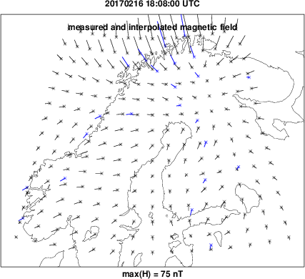
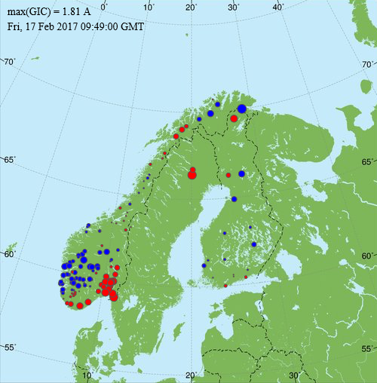
SWE Service For Power Grid Operators
Monitoring potential GIC levels in power systems using state of the art models and near real-time ground magnetic field recordings.

Slide 16
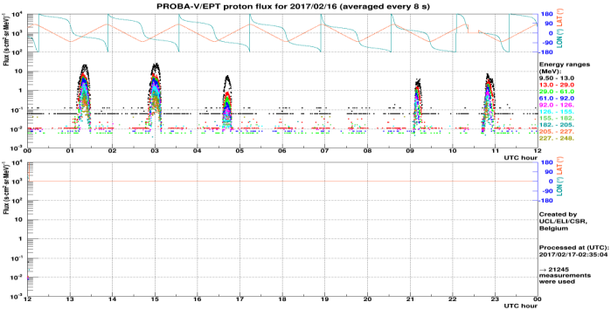
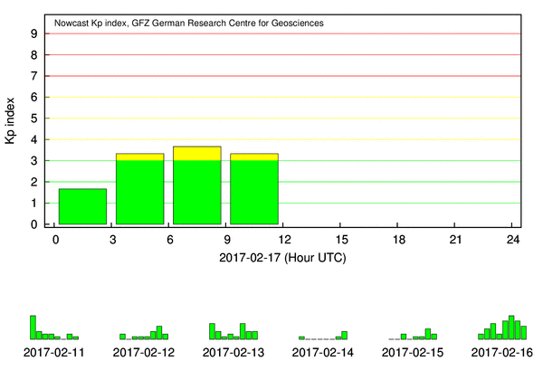
SWE Service For Spacecraft Operators
Near real-time estimate of space environment and its effects on spacecraft operations.
Monitoring phenomena e.g. geomagnetic storms, substorms, high-speed streams, solar energetic particle events & Earth-directed CMEs.

Slide 17
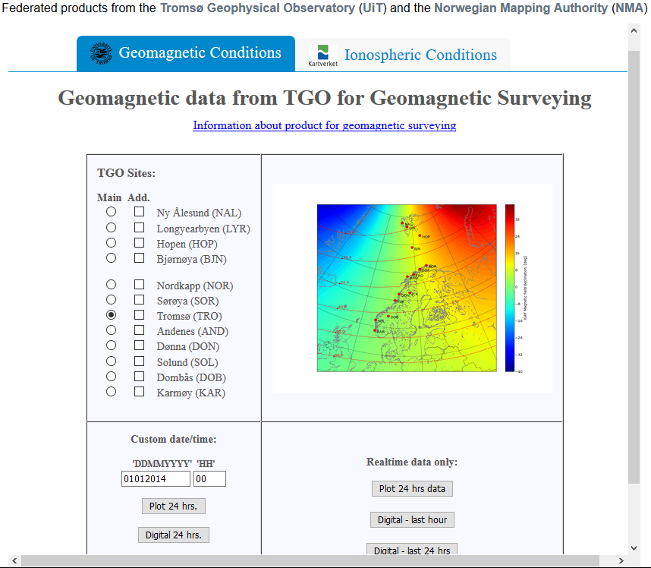
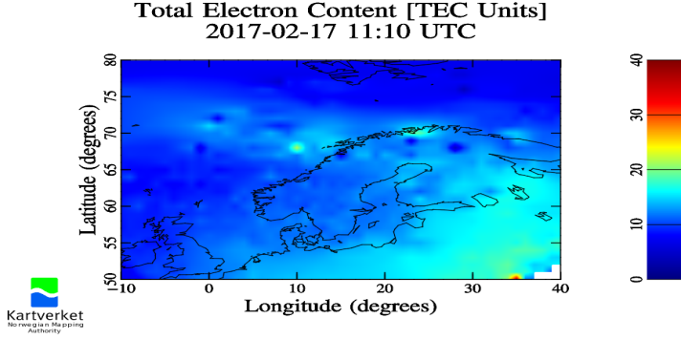
SWE Service For Resource Exploitation System Operations
Near real-time information about geomagnetic disturbances affecting directional drilling and aeromagnetic surveys, combined with ionospheric disturbances affecting related GNSS-based activities.

Slide 18
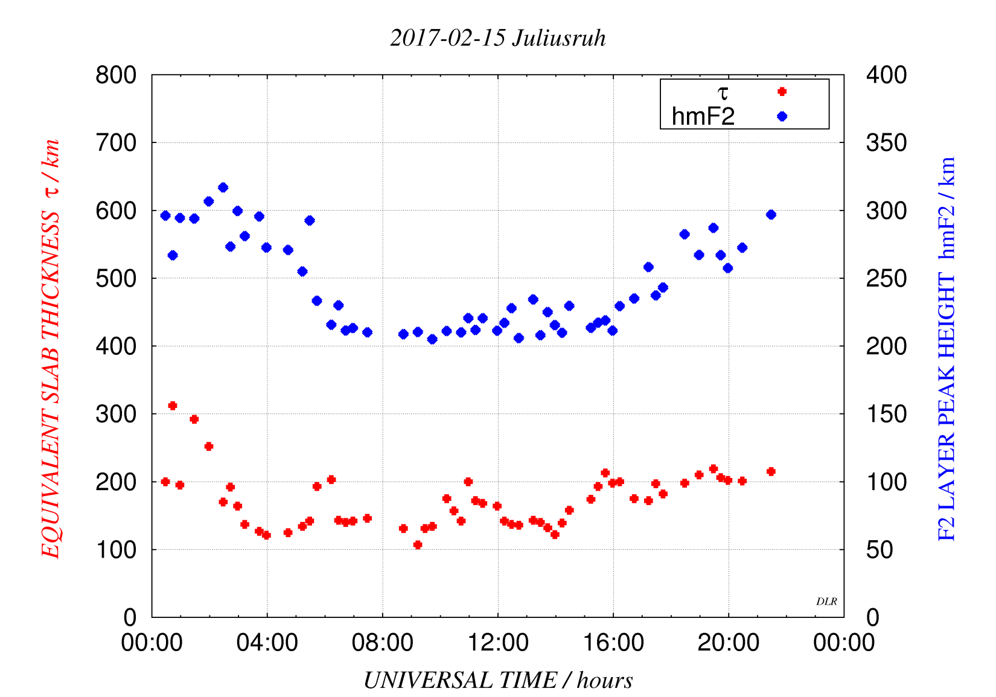
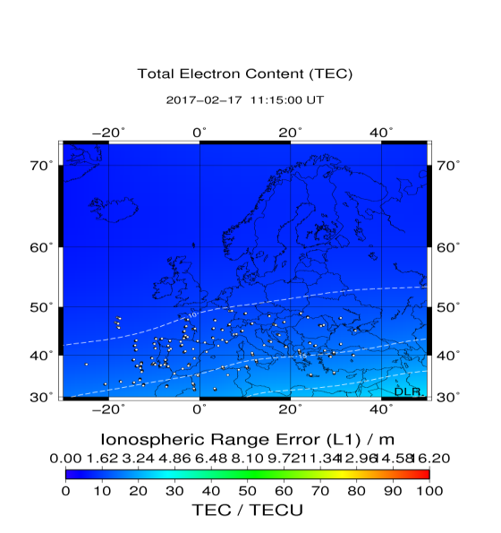
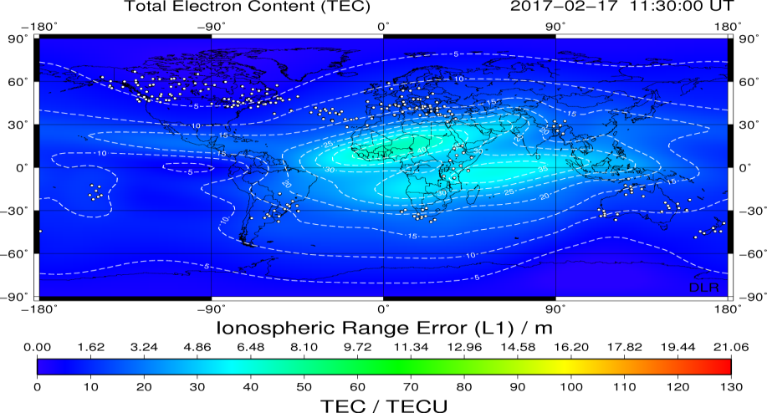
SWE Services For GNSS Users: Trans-ionospheric radio link
Near real-time and short-term Total Electron Content and ionospheric parameters indicating current level of ionospheric disturbance. Regional and global view.

Slide 19
International cooperation
A global issue
ESA/SSA applying collaborative approach, within Europe and beyond (e.g. US – NOAA and NASA, Korea)
Increases footprint and decreases costs
Connects SWE stakeholders across nations and creates synergies.

Slide 20
THANK YOU
swe.ssa.esa.int
www.esa.int

